Slide 1

DUH1A2 ICT Literacy MENCARI INFORMASI DARI INTERNET
Eko Darwiyanto
Semester Ganjil – TA 2016/2017

Slide 2
Pembahasan:
Kebutuhan akan informasi
Penentuan sifat dan luasnya informasi
Pencarian yang efektif dan efisien
Tujuan Pembelajaran :
Paham Algoritma Perulangan
Mampu mengimplementasikan algoritma perulangan pada bahasa pemrograman

Slide 3
Informasi itu berharga
Sudah mirip makanan, air dan listrik, manusia butuh informasi.
Informasi penting untuk suksesnya pendidikan, karir atau bisnis.
Informasi yang sangat penting bahkan dapat diperjualbelikan.
Informasi yang berkualitas dapat digunakan untuk:
mendukung menyelesaikan tugas-tugas kuliah
menghemat waktu pengerjaan tugas
mencari gagasan baru
membantu membuat keputusan

Slide 4
Factor-faktor yang berpengaruh
Mutu informasi dipengaruhi oleh faktor-faktor berikut:
Up-to-date
Lengkap
Relevan
Akurat
Dapat dihandalkan
Tersaji baik
Potensi penggunaan informasi adalah faktor penting dalam menentukan nilainya. Makin berpotensi makin bernilai.

Slide 5
Up-to date
Cari informasi terbaru untuk segala hal
Kapan terakhir registrasi? Apa syaratnya?
Apakah ada perubahan jadwal pengumpulan tugas dari Dosen?
Apa artikel jurnal terbaru tentang topik yang dibahas Dosen?

Slide 6
Lengkap
Informasi yang tidak/kurang lengkap dapat membuat keputusan keliru.
Peta jalur selatan jawa minggu lalu kosong, semua pada lewat jalur selatan, akhirnya jalur selatan macet.
Data penjualan dua triwulan, tidak memberikan gambaran lengkap kinerja bisnis tahunan.
Gagal melihat dukungan luas masyarakat Turki terhadap Presiden Erdogan, membuat kudeta gagal.

Slide 7
Relevan
Informasi yang dicari harus relevan dengan yang dibutuhkan
Cari jalur alternatif pantura, yang setelah melaluinya dapat kembali ke pantura lagi. Lewat Google Map dapat, tapi tidak dapat kembali ke pantura lagi, berarti tidak relevan.
Survey ke mahasiswa yang jarang pakai Icaring untuk menilai tingkat penerimaan Icaring, tidak relevan. Yang relevan, justru yang sering pakai.

Slide 8
Akurat
Meskipun tidak mungkin akurat 100%, setidaknya cukup akurat untuk membuat keputusan
Jumlah stok barang yang keliru di Toserba, dapat berakibat stok kosong atau pesan barang berlebihan (keduanya buruk untuk organisasi)
Perkiraan jumlah kendaraan yang akan melewati tol Brebes timur seharusnya akurat, agar dapat diperkirakan pengaturan jalur lalu lintas pantura.

Slide 9
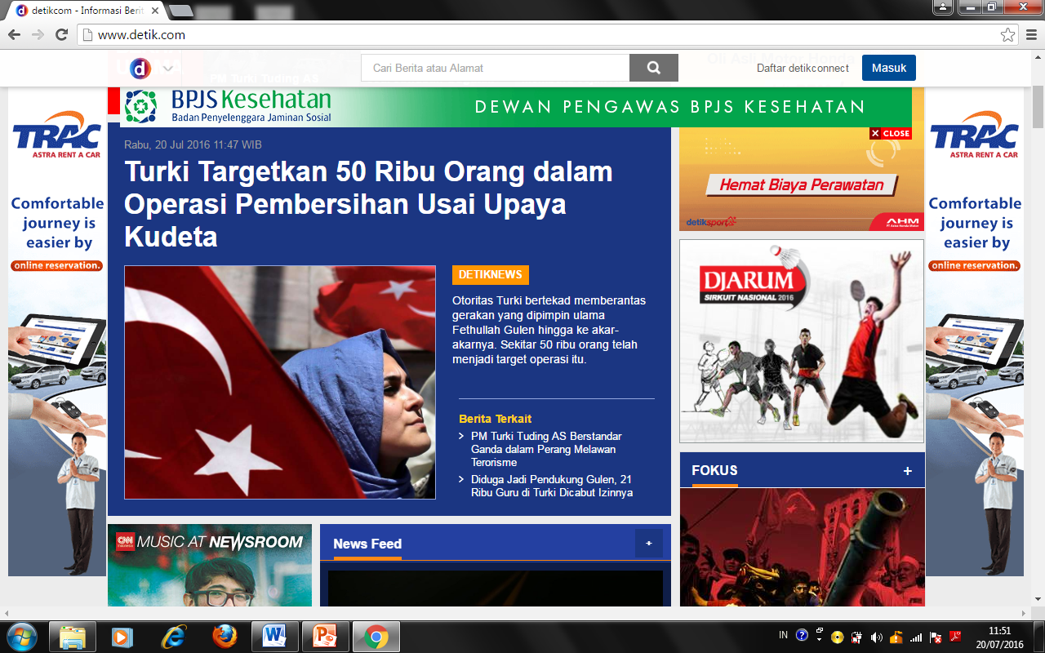
Dapat dihandalkan
Berita dari sumber yang tidak/kurang dapat dipercaya perlu diperiksa kebenarannya (cross check, tabayun).
Berita dari sumber yang dapat dihandalkan dapat dimanfaatkan.
Detik.com, Kompas, dll dapat dihandalkan

Slide 10
Tersaji baik
Informasi disajikan dalam format yang mudah dipahami pembaca
Pembuat keputusan butuh informasi yang mudah dipahami
Cari gambar pengganti kata-kata yang banyak
Sebagian gambar sebagian kata-kata

Slide 11
Perlu usaha untuk mendapat informasi yang bermutu
Usaha untuk mengumpulkan
Usaha untuk menyimpan
Usaha untuk mengolah
Usaha untuk merawat

Slide 12
Internet
Internet adalah sumber informasi penting, selain koran, TV, dan media masa lainnya.
Namun menemukan isi web yang berkualitas dan memanfaatkannya untuk membantu menyelesaikan tugas adalah pekerjaan yang menantang.
http://wikipedia.com
Notes:
Rationale: With the development of the Internet, students have found that conducting research is much easier and more convenient than searching through library stacks. While the Internet can be a great tool for research, locating quality materials can at times be a challenge. The following slides will offer tips on how to make the most of your Internet search.
Activity: To generate discussion, the facilitator may ask students about their level of familiarity with the Internet. Also, the facilitator may ask students about the types of web sites they visit, as well as if they have their own personal web pages.

Slide 13
Evaluasi web
Setiap orang dapat mempublikasikan apapun di internet.
Perlu diperiksa kebenarannya, buktinya, redaksi kalimatnya, ejaan katanya.
Notes:
Activity: The facilitator might ask students why it is important to evaluate web sources. The answers offered on this slide highlight the importance of web source evaluation.
.
Key Concepts: Books and journal articles generally go through a long process of fact-checking, editing, and revising before being published. However, anyone with a computer and Internet access can post a web site. Just because the information is published online, it does not mean it is true or reliable. The facilitator may note that web sites change frequently and sometimes disappear quickly.
Thinking about evaluation within the search process can help to make web browsing efficient and effective.
Click the mouse after the title question.

Slide 14
Mencari di Internet
Gunakan mesin pencari
Identifikasi web site
Periksa kredibilitasnya
Tentukan kedalaman dan keluasan ruang lingkup informasi
Periksa tanggalnya
Notes:
Rationale: This slide previews the five areas of web location and evaluation that this presentation will cover.

Slide 15
Tipe web
Web informatif
Web Personal
Web kelompok politik/kepentingan
Web pemasaran
Web hiburan
Notes:
Key Concepts: There are several different types of web pages on the Internet. Students researching the web tend to think that the majority of web pages are devoted to providing information. Generally, informative sites--pages that offer information for the public good without any type of overt political or sales agenda--are few and far between.
Personal web pages tend to be devoted to an individual’s interests, hobbies, family, friends, or ideological beliefs. While researching, students may find personal web pages being used as a sounding board for a political agenda. Though some sites contain well-researched and reliable information, others do not.
Political or interest group pages generally promote some type of cause or way of thinking. These sites will educate web surfers about their topics, but they may contain slanted or biased information. Their goal is to offer information in the hopes of changing a belief, gaining a vote, or earning a political contribution.
Students have the hardest time distinguishing between pages that provide information and pages that try to sell a product. For example, a web site that informs about the benefits of aromatherapy may also sell aromatherapy products. While some “infomercial” sites clearly are promoting a product, the business agenda of other sites can be more difficult to assess.
Finally, the Internet contains many entertainment-oriented web sites. These sites can range from movie news and games to cartoons and comic book sites. Still other pages are “joke” pages--pages that look like they contain serious information, but really contain elaborately fabricated content. If readers are not careful researchers, they may mistake these “joke” pages for reliable information.
Click the mouse for each type of web site.

Slide 16
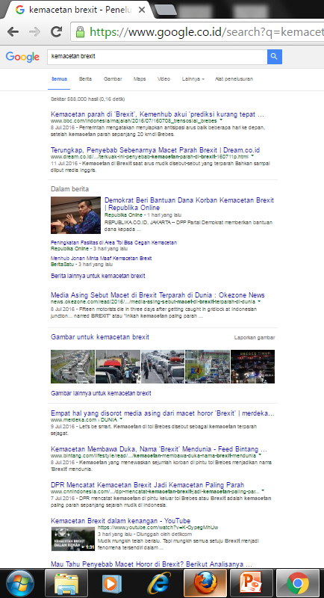
Mesin pencari (search engine)
Mesin pencari mencari lokasi web dan menampilkan hasil pencarian berdasarkan popularitas.
Notes:
Key Concepts: This slide defines a search engine--a tool that can search through web pages and sort them according to specified keywords. Search engines are essential for researching the Internet: they have the ability to locate and sort through millions of web pages.
Activity: The facilitator may choose to generate discussion by asking students to explain what a search engine is.
Click after globe appears for the answer to the title question.

Slide 17
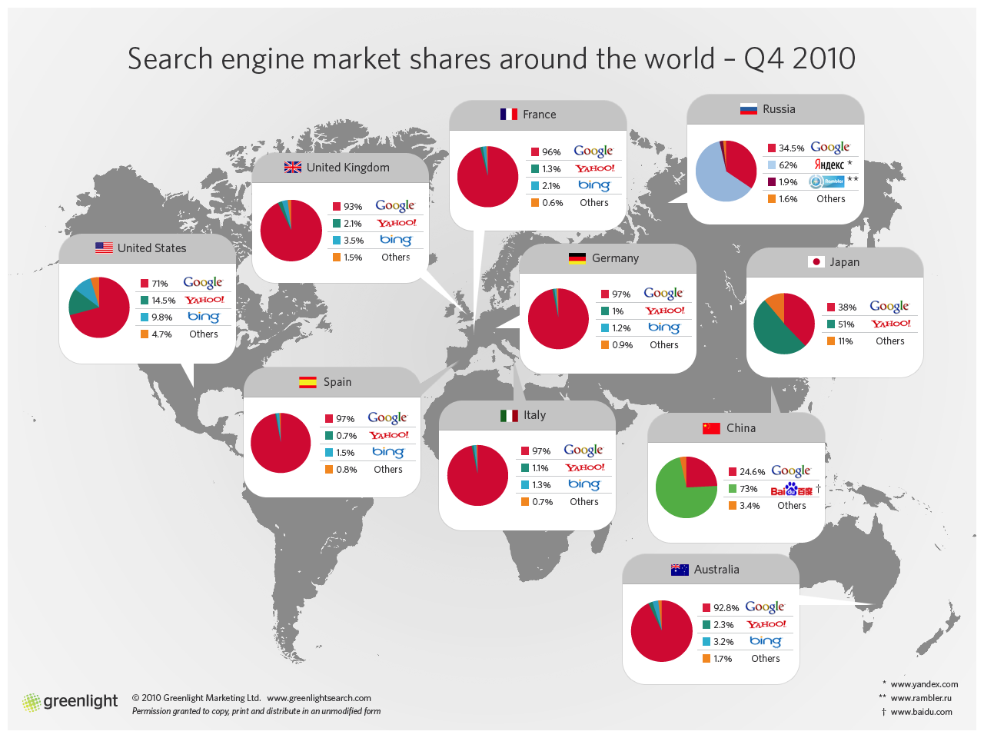
..
Notes:
Activity: The facilitator may ask students about they types of search engines they use. They will list many for you--Yahoo, Alta Vista, Excite, Lycos, Hotbot, Infoseek, Northern Light, Snap, Dogpile, etc.
Key Concepts: Each search engine searches the web in a slightly different way. Also, companies or individuals often must register their web sites with these different search engines, so the list that comes up on Yahoo may be completely different from the one that comes up on Lycos. A wide variety of search engines may be accessed at the OWL web site, located at owl.english.purdue.edu.
When researching a topic, it is also a good idea to do some brainstorming about the best places on the web to locate information. Government agencies and non-profit groups may host web sites that offer useful information.
Activity: The facilitator may choose either now or after the presentation to minimize the PowerPoint presentation, access Netscape or another Internet browser, or go the the collection of search engines on the OWL web site.

Slide 18
Gunakan kata kunci yang tepat
Or
Pilih kata kunci (keyword) yang tepat sebelum browsing.
Pernahkah anda pakai “AND” atau “OR” untuk mencari dengan dua atau lebih kata kunci ?
Cancer
Lawsuit
Tobacco
Legislation
Smoking
And
Teenagers
Advertising
Notes:
Key concepts: This slide offers tips for using search engines. Since search engines do not all work in exactly the same way, it is a good idea to read the directions of your selected search engine prior to conducting a search. Also, using Boolean operators--words like “AND” and “OR”--can help to tailor a search to your needs. It is also a good idea to brainstorm a list of keywords that might fit your topic. The slide offers an example for a search on the tobacco lawsuits and settlements. Depending on the angle of your topic, you might choose a variety of these terms in combination with each other.

Slide 19
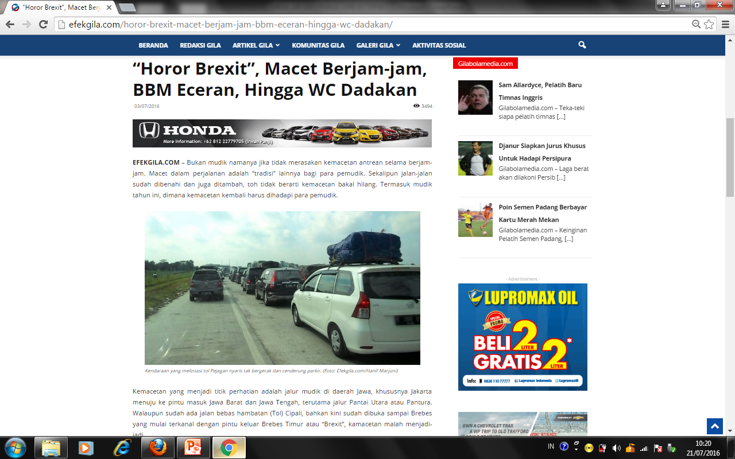
Identifikasi halaman web
Banyak halaman web tidak diperiksa keakuratannya.
Web personal sering digunakan untuk menyatakan opini pribadi tentang sesuatu, bukan fakta.
Jadi, periksa siapa pemilik web, siapa audiensnya, siapa yang menulis artikel, apa isinya, dan apa tujuannya.
Bedakan iklan atau fakta
Notes:
Key Concepts: After using search engines to locate some potentially helpful web sites, your next step is to identify the site. This involves determining the authorship, content, and purpose of the web site.

Slide 20

Periksa kredibilitas
Siapa penulis halaman web?
Individu atau kelompok?
Periksa informasi tambahan setelah informasi penulis ditemukan
Adakah agenda bisnis atau politik?
Siapa sponshor web? Siapa mereka?
Notes:
Key Concepts: Again, asking yourself a list of questions is the best way to determine the credibility of the web site. Is the author listed? Credentials? If you can find the author’s name, try typing it into a search engine to see what else pops up. Is the author affiliated with a political group or a business? If so, try typing the name of the group into a search engine to see what else pops up.

Slide 21
..
Apakah halaman web menyebutkan rujukan, pekerjaan yang di-sitasi?
Apakah rujukan dapat dilacak? Sumber rujukan dapat dihandalkan?
Adakah link ke web lain yang dapat dihandalkan?
Adakah email ke pengarang?
Notes:
Key Concepts: This slide provides additional questions to test the credibility of a web page. A list of sources indicates the inclusion of source material in the web content, but it is a good idea to check out some of the sources as well. Sources listed on the Works Cited page may also prove useful to the researcher. Does the web site link to other related sites? If the linked sites are not very reliable, you may question the credibility level of the author’s own site--such links show poor judgment. Also, can the author or webmaster be contacted? If so, they may be willing to answer questions about their web site or even consent to an e-mail interview!

Slide 22
Menentukan kedalaman dan luas ruang lingkup informasi
Perbedaan halaman web dengan sumber tercetak:
Informasi sering ditampilkan agar mudah dicerna dengan tampilan menarik.
Informasi sering tidak mendalam atau tidak luas.
Materi bisa jadi dpengaruhi kepentingan bisnis atau politik.
Kadang-kadang halaman web bukan sumber yang benar terhadap informasi yang anda perlukan.
Notes:
Key Concepts: Web researchers need to determine the depth and scope of information provided on web pages. Remember, looking at the Internet on a computer monitor is very similar in some ways to watching a giant television: web pages are generally designed to be visual appealing for quick and easy digestion by the viewer. Consequently, information may not be presented as thoroughly as it might be in a book or journal article. Also, the material included on web pages may be dramatically altered to fit the marketing or political agendas of the publishers.
Finally, the facilitator may want to stress that web sources are not always the best sources of information. Students sometimes tend to have an overreliance on the Internet, thinking that all information is out there somewhere in cyberspace. The best research students can do is to combine web sources with other print sources, including books, magazines, and academic journals, as well as interviews and questionnaires.

Slide 23
Menentukan kedalaman dan luas ruang lingkup informasi
Apakah halaman web menunjukkan tanda-tanda hasil penelitian, referensi ke sumber lain, hyperlinks, catatan kaki, dll?
Apakah halaman web menginformasikan perubahan/perkembangan topik kajian?
Apakah pengarang memperhatikan sudut pandang lain?
Seberapa cocok/sesuai/dekat isi halaman web dengan yang Anda cari?
Bandingkan dengan sumber-sumber lain, pilih mana yang paling konsisten
Notes:
Key Concepts: This slide again offers a list of questions that students should ask when they review web sites for their depth and scope of information. Also, students need to allow themselves enough time to research their work. Encourage them not to just use information from the first five web sites they locate--they should find the five best web sites on their topics.
Activity: The facilitator may ask students why the consideration of opposing points of view is important in a well-researched web site. The presence of opposing viewpoints suggest that the author has carefully considered multiple viewpoints about an issue and has come to an educated conclusion about the issue.

Slide 24
Periksa tanggal informasi
Anda lihat tanggal di halaman web?
Tanggal di halaman web dapat berarti:
Tanggal awal artikel ditulis
Tanggal publikasi di internet
Tanggal tidak di-update, termasuk jika ada revisi, tambahan atau pengurangan materi.
Notes:
Key Concepts: Though information on web sites may be credible, it may not be current. The date of the material may be completely omitted from the web site. To be sure you are covering all of the recent changes in the field or topic you are studying, be sure to assess the currency of your information. This is not always an easy task.

Slide 25
Pencarian yang efektif dan efisien
Model standar pencarian informasi
Tahap pencarian informasi
URL
Searching techniques
Search engines

Slide 26
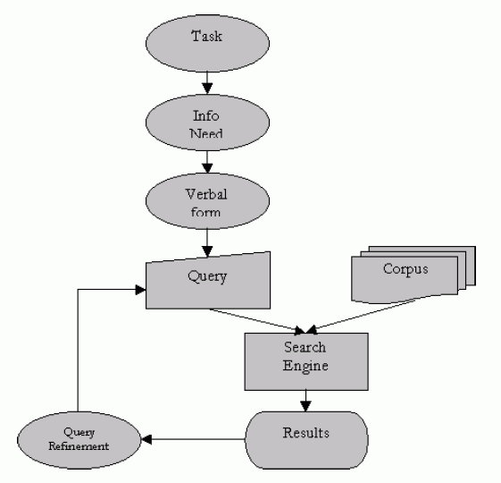
Standard model of information seeking
Special case of problem solving
Information seeking process
Problem identification
establishing a plan of search
conducting the search
evaluating the results
and if necessary, iterate

Slide 27
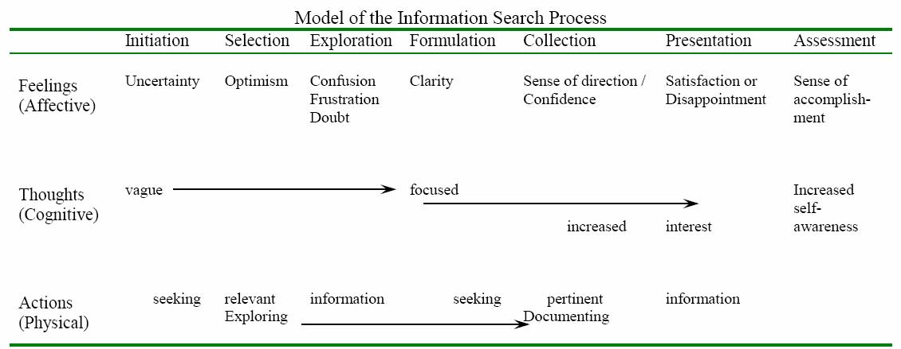
Information seeking in stages (Kuhlthau)

Slide 28
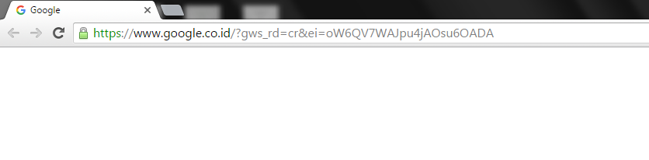
URL
Uniform Resource Locator
Alamat web yang menghubungkan Anda dengan website
Pergi ke alamat di atas layar Google/Yahoo/Bing
Itu alamatnya

Slide 29
Komponen URL
http://www.starwars.com/seminars.html
http://--hypertext transfer protocol:
protokol pertukaran data hyper text (text dengan tambahan tag
www—world wide web:
informasi dari seluruh dunia yang dapat diakses melalui internet
.starwars—nama domain:
nama halaman web
.com—top level domain:
web sejenis dikelompokkan di sini
/seminars—file name:
folder dalam website
.html—hypertext markup language:
bahasa untuk menampilkan format text

Slide 30
Top Level Domain
.edu—higher education
.k-12—elementary and secondary schools
.com—commercial
.gov—government agency
.mil—military
.org—general noncommercial organization
.net—computer network
.go.id : dinas pemerintah Indonesia
.sch.id : sekolah Indonesia
ac.id : akademi Indonesia

Slide 31
Sebelum browsing
Persiapkan
Organisasikan
Kombinasikan

Slide 32

Persiapan
Apa yang perlu Anda ketahui tentang topik yang Anda pelajari?
Buat daftar semua kata penting terkait topik.
Termasuk nama-nama pengarang, organisasi dan frase-frase kata.

Slide 33
Organisasikan
Buat daftar kata yang kritis untuk pencarian Anda.
Catat kata-kata yang tidak Anda inginkan untuk tampil.
Abaikan sisanya.
Contoh
Anda ingin mencari kos-kosan di seputar kampus,
seharusnya Anda tidak perlu tergoda dan tertarik untuk melihat berita tentang Artis X, politik dsb.
Ingat itu.
Kata-kata apa lagi yang mungkin terkait dengan topik kajian Anda tetapi akan membawa Anda ke website hiburan?

Slide 34
Kombinasikan
Gunakan operator Boolean untuk mengkombinasikan kata-kata kunci.
“kata1” AND “kata2” : halaman web berisi kata1 dan kata2
NOT “kata3” : halaman web tidak berisi kata3
“kata1” OR “kata2” : halaman web berisi kata1 atau kata2
Gunakan huruf kecil, kecuali untuk singkatan.

Slide 35
Dimana Mencari
Search engines :
Google, Yahoo, Bing, Alta Vista, Excite, Hotbot, Infoseek.
Academic/scientific database :
http://www.link.springer.com
http://ieeexplore.org
http://dl.acm.org
http://www.sciencedirect.com
Social Media : facebook, twitter, dll
Blogging : wordpress, blogspot, dll
Social News : slashdot, fark, digg, reddit
Forums : Delphi Forums

Slide 36
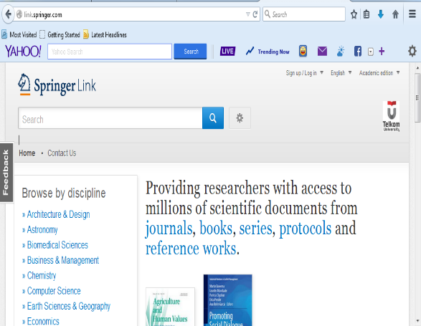
http://www.link.springer.com

Slide 37
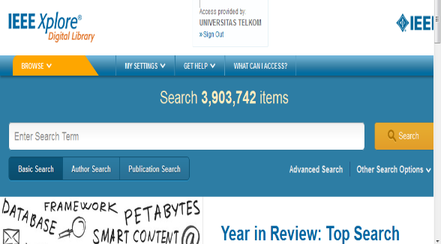
http://ieeexplore.org

Slide 38
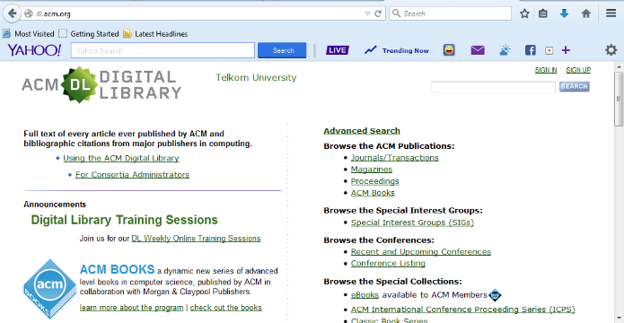
http://dl.acm.org

Slide 39
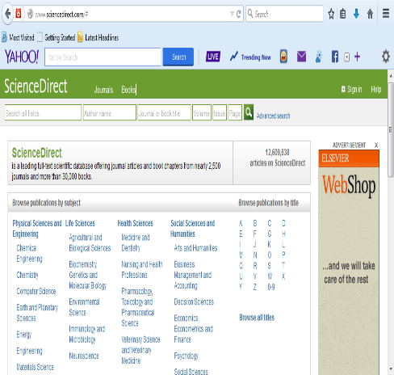
http://www.sciencedirect.com

Slide 40
Latihan
Diskusikan bertiga dengan rekan-rekan masing-masing
Carilah informasi sebagai berikut:
1. Sebutkan dan pilihlah travel untuk trayek Buah Batu (Bandung) ke Rawamangun (Jakarta). Tulis detail proses, strategi dan keyword yang digunakan untuk mencari informasi ini?
2. Untuk suatu issue kesehatan (misalnya: apakah kopi itu baik/tidak untuk kesehatan), maka sumber informasi apa saja yang digunakan dan bagaimana kita menilai apakah informasi yang dihasilkan valid/tidak?
3. Bagaimana untuk mendapatkan informasi yang umum? Bagaimana mendapatkan informasi yang lebih spesifik? Beri penjelasan dan berilah contohnya?

Slide 41
Referensi
FatMax 2007, Value & Importance of Information ppt.
Purdue University Writing Lab, Research and The Internet ppt
http://www.greenlightdigital.com/assets/images/market-share-large.png
Mrs. Kotsch, Preparing To Search The Internet ppt, St. Elizabeth Ann Seton School c2004
Dodge, Bernie. “Seven Steps to Better Searching.” San Diego State University College of Education. July 8, 1999.http://projects.edtech.sandi.net/staffdev/tpss99/searching/sevensteps.htm.
Marti A. Hearst, Search User Interface, Cambridge, 2009

